Slide 1


KRED: Knowledge-Aware Document
Representation for News Recommendation[1] Study
Amirshayan Nasirimajd, Bardia Karimizandi, Arman Behkish
299823 301366 299525
NLP
A.A 2022/2023
[1] Liu, Danyang, et al. "KRED: Knowledge-aware document representation for news recommendations." Proceedings of the 14th ACM Conference on Recommender Systems. 2020.

Slide 2

Introduction
Results
Conclusion
Extensions
overview
Problem Overview
Incorporating Knowledge entities for better document understanding benefits recommendation tasks, i.e., Personalized / item-to-item recommendation, news category classification, news popularity prediction, and local News detection.
Document representation models either do not use knowledge entities or rely on the specific type of text encoding, losing generalization ability and efficiency.
Integrating external information, i.e., knowledge graphs to fuse entities into a latent representation of the news document greatly benefits recommendation performance.
Most relevant works, e.g., DKN[1] are inefficient.
[1] Wang, Hongwei, et al. "DKN: Deep knowledge-aware network for news recommendation." Proceedings of the 2018 world wide web conference. 2018.

Slide 3
Introduction
Results
Conclusion
Extensions
overview
KRED
Given an arbitrary Document Vector (DV), it produces a Knowledge Enhanced Document Vector (DKV) to be consumed by various downstream recommendation tasks.
No constraint on document representation.
Fast, no computation of the whole text string.
Uses Knowledge Graph to enrich entity embeddings.
Multi-task training to share valuable information between different tasks.

Slide 4
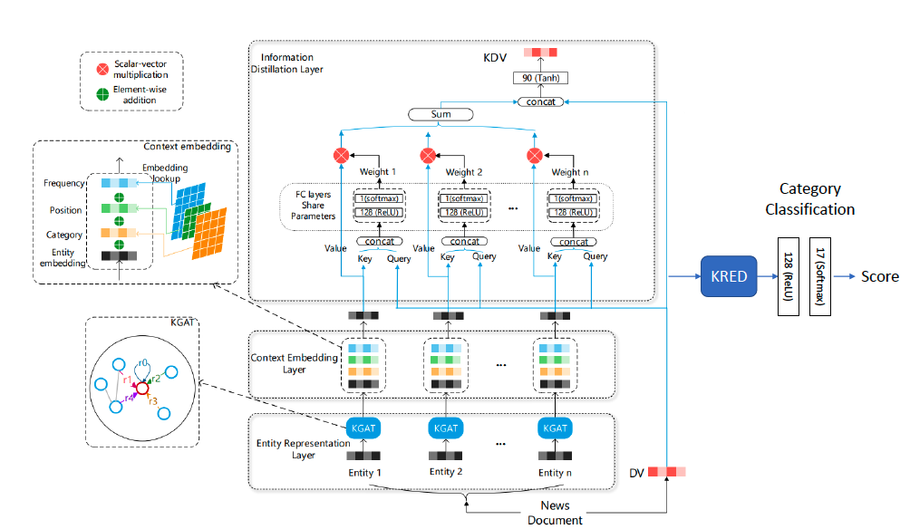
Introduction
Results
Conclusion
Extensions
overview
Overview of the Pipeline
Entity Representation Layer
          TransE[1] for entity Embedding
          KGAT to extract neighborhood information
          Context Embedding Layer: Dynamic context to specify the importance/relevance of the entity
                Position Encoding
                Category Encoding
                Frequency Encoding
          Information Distillation Layer
          Attention under the supervision of the original document vector
          Concatenate the result with DV to produce KDV
[1] Bordes, Antoine, et al. "Translating embeddings for modeling multi-relational data." Advances in neural information processing systems 26 (2013).

Slide 5
Introduction
Results
Conclusion
Extensions
overview
Model Investigation : Change Sentences Embedding
RoBERTa[1]:
        Trained on Larger Dataset
        Better Training Procedure
      Better results
      Same Embedding size as BERT
MiniLM[2]:
Simple Language Model
Faster than BERT
Lower Embedding Size
[1] Liu, Yinhan, et al. "Roberta: A robustly optimized bert pretraining approach." arXiv preprint arXiv:1907.11692 (2019).
[2] Wang, Wenhui, et al. "Minilm: Deep self-attention distillation for task-agnostic compression of pre-trained transformers." Advances in Neural Information Processing Systems 33 (2020): 5776-5788

Slide 6
Introduction
Results
Conclusion
Extensions
overview
Model Capability in more Challenging Tasks
Cathegory Classification: 17 classes.
Sub-Cathegory Classification. : 263 classes.

Slide 7
Introduction
Results
Conclusion
Extensions
overview
Context Embedding Ablation Study
Eliminate Positional Embedding: Entities in Body and title have the same priority.
Eliminate Frequency Embedding: The occurrence of entities does not matter.
Eliminate Type Embedding: The category of entities is not considered.

Slide 8
Introduction
Results
Conclusion
Extensions
overview
Setting and Dataset
MIcrosoft News Dataset (MIND)[1]
Setting
Parameter | Value
Batch size | 64
epochs | 100
Optimizer | Adam
learning rate | 0.00002
weight decay | 0.000001
160k English news articles
15 million impression logs generated by 1 million users
WIKIDATA Knowledge graph
behaviors
news
entity_embedding
relation_embedding
Containing
[1] Wu, Fangzhao, et al. "Mind: A large-scale dataset for news recommendation." Proceedings of the 58th Annual Meeting of the Association for Computational Linguistics. 2020.

Slide 9
Introduction
Results
Conclusion
Extensions
overview
Results
Setting | Accuracy | F1 score | Gain
Baseline | 70.81 | 0.35 | -
RoBERTa | 75.18 | 0.51 | +4.37
MiniLM | 65.08 | 0.22 | -5.37
Model Exploring:
General Category vs Sub-Category:
Setting | Accuracy | F1 score | Gain
Baseline | 70.81 | 0.35 | -
263 class | 34.68 | 0.02 | -36.13
Context Embedding Ablation Study:
Setting | Accuracy | F1 score | Gain
Baseline | 70.81 | 0.35 | -
No Type | 70.11 | 0.34 | -0.7
No Position | 71.1 | 0.36 | +0.29
No Frequency | 70.84 | 0.35 | +0.03

Slide 10
Introduction
Results
Conclusion
Extensions
overview
Conclusion
Language model used in KRED can impact and improve the Performance.
KRED performance is not unbiased over all classes .
KRED model is not robust in classifying detailed class topics.
In news Categorization, in context embedding type play more important rule than position.

Slide 11

Thank You For Your Attention

